Slide 1
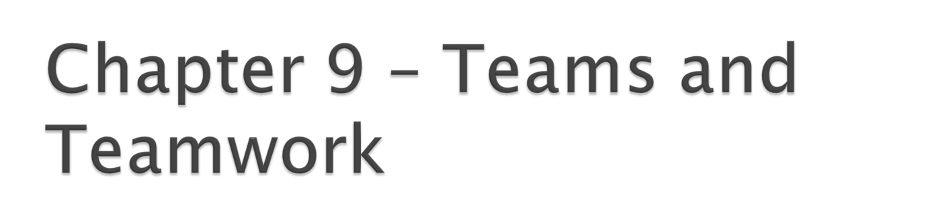
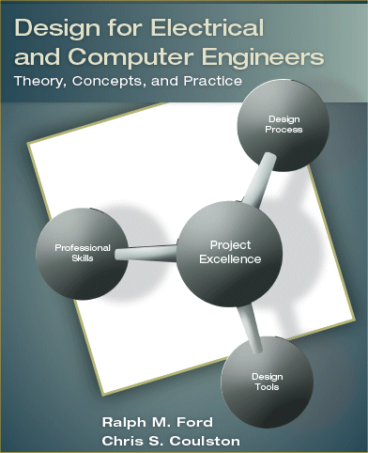

Slide 2

Engineering projects are far too large to be carried out by a single person ⇒ must work on team.
High-performance teams can outperform equal number of individuals working in isolation.
Employers desire it – consistently listed as one of the top skills required of engineers!

Slide 3

Understand the characteristics that define a team and understand why a team is formed.
Understand different models for the stages of team development.
Understand the characteristics of effective teams.
Be able to develop Team Process Guidelines.

Slide 4

“A small group of people with complementary skills, who are committed to a common performance, performance goals, and approach for which they hold themselves mutually accountable.” , Katzenbach and Smith
What are the important points ?
Notes:
Small group – how small is small. Discuss the number of relationships diagram.
Complementary skills – means that if everybody can do the same thing, almost no reason to have a team
Common performance & performance goals – they agree upfront on the goals (requirements).
Mutually accountable – they have a way to work their problems out - without outside intervention.

Slide 5

Forming
Storming
Norming
Performing
Adjourning
Notes:
Forming.
Team created
Uncomfortable, anxious
Don’t know goals
Don’t know roles
Storming
Work to develop objectives
To develop roles
Often conflict
Need to navigate.
Norming
People accept objectives
Accept roles
Develop procedures for working together.
Performing
Doing it
Making decisions.

Slide 6

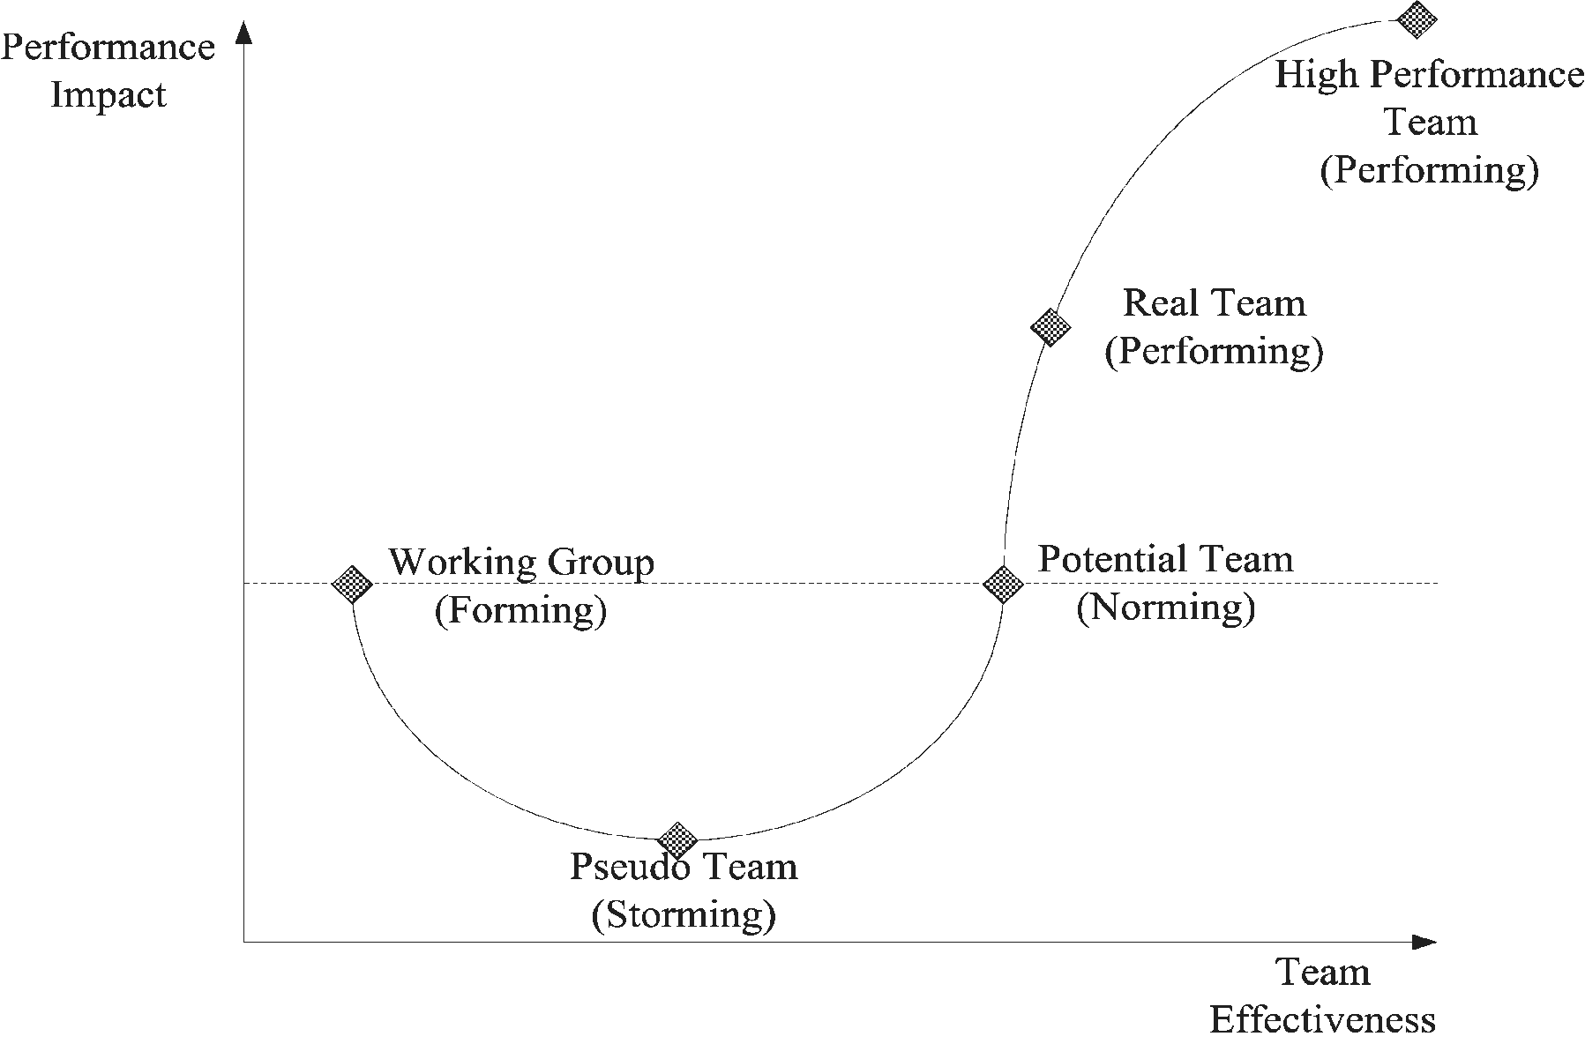
Notes:
Working Group
Not really a team – a collection of individuals
Pseudo-Team
We’ve had them. Fight all the time.
Potential Team
Reasonable, but not great
Real Team
Collective outperforms the individuals. This is where you want to be
High-Performance
Exceptional performance – occasionally see it in Sr. Design.

Slide 7
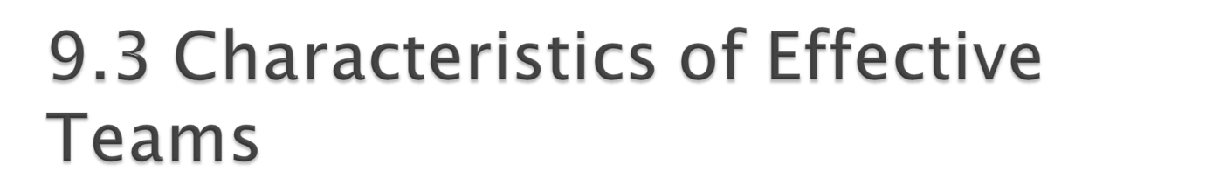
Select Team Members Based Upon Skills.
Identify and Agree Upon Objectives Upon Objectives.
Make it Clear How the Team will Make Decisions!
Hold effective meetings.
Determine team roles.
Assign tasks & responsibilities.
Spend a lot of time together.
Respect team members.
Manage conflicts constructively.
Notes:
Skills
Technical & functional
Problem-solving
Interpersonal
Others

Slide 8
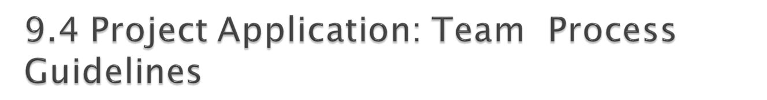
A set of guidelines/rules (your constitution) that governs the performance of your team behavior.
See book for contents
See the Team Self-Assessment Checklist (Table 9.1) in the book.

Slide 9

Every member responsible for team’s progress and success.
Attend all meetings, be on time.
Come prepared.
Carry out assignments on schedule.
Listen to and show respect for the contributions of others; be an active listener.
Constructively criticize ideas, not persons.
Resolve conflicts constructively.
Pay attention; avoid disruptive behavior.

Slide 10

No disruptive side conversations.
Only one person speaks at a time.
Everyone participates; no one dominates.
Be succinct; avoid long anecdotes and examples.
No rank in the room.
Respect those not present.
Ask questions when you do not understand.
Have fun

